Slide 1

PhonePe Transaction & User Analytics
Apponix Academy
( Capstone Project 2 )
Name : M Adithya
Guide : Azra Ma’am
Date : 25-06-2026

Slide 2

Problem Statement
This project aims to:
Analyze PhonePe transaction trends
Understand user engagement patterns
Track growth in digital payments
Support business decision-making using SQL, Python, and Power BI

Slide 3
Key Questions
1.Which state has the highest transaction value?
2.Which state has the highest transaction count?
3.How have transactions grown over time?
4.Which districts contribute most to digital payments?
5.Which payment categories dominate transactions?
6.Which states have the highest user engagement?
7.How does user growth vary across regions?
8.Which areas should PhonePe focus on for expansion?3.

Slide 4
Dataset Overview
Phonepe -Final-Dataset :
3 Relational Sheets
All_Users : 107,658 user profiles (ID, Name, Age, Join Date)
All_Transactions : 300,000 transaction records spanning 12 descriptive attributes
Money_Transfer : 150,000 records capturing specific transfer dynamics
Executed structural data connections between user profile demographics (All_Users) and transaction activities (All_Transactions) utilizing the unique User_ID relational key to achieve a comprehensive master dataset.

Slide 5
Data Cleaning & Preprocessing
Excel
Removed duplicates
Standardized column names
Checked missing values
Corrected data types
Result
No Missing Values, Clean Dataset , Ready for Analysis

Slide 6
SQL Concepts Used
PostgreSQL Concepts
Aggregate Functions
GROUP BY
CASE Statements
Views
Window Functions
Ranking Functions
Joins

Slide 7
Python EDA Insights
Overall Metrics:
Analyzed over 300,000 baseline interactions across multiple transactional modes.
Status Distribution:
The vast majority of payment requests conclude successfully, with controlled drops attributed to specific system bottlenecks.
Core Channels:
"To UPI ID" and "To Self Account" present leading transaction counts among digital money transfers.

Slide 8
Dashboard Demonstration 1
Important KPIs
1.Total Transaction Value
2.Total Transactions
3.Average Transaction Value
4.Active Users
5.Failed Transaction Value

Slide 9
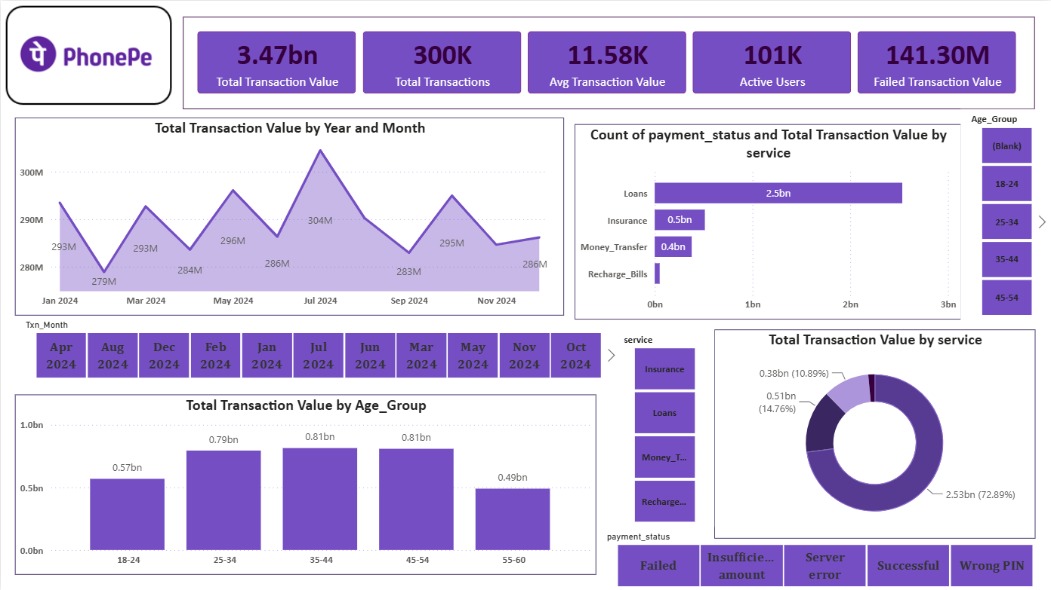

Slide 10
Dashboard 1 Analysis
KPI Cards
Total transaction by month
Payment status by service
Transportation by age group
Transaction value by service
Slicers

Slide 11
Dashboard Demonstration 2
Important KPIs
MT Total value
MT Total Count
MT Avg Transfer value
MT Active Senders
MT Failed value

Slide 12
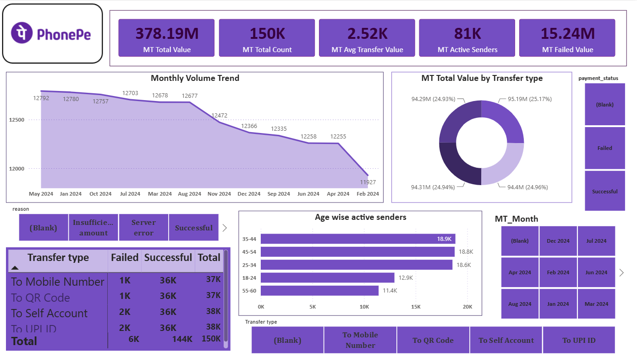

Slide 13
Dashboard 2 Analysis
KPI Cards
Monthly volume Trend
MT Total Value by Transfer Type
Age wise Active Senders
Slicers

Slide 14
Business Recommendations
Improve failed payment handling.
Promote high-value transfer methods.
Optimize services with lower usage.
Increase engagement among low-activity age groups.
Strengthen fraud monitoring.
Enhance customer support for failed transactions.
Introduce targeted cashback campaigns.

Slide 15
Achievements
Excel Data Cleaning
PostgreSQL Analysis
SQL Queries
Python EDA
Power BI Dashboard
Business Insights

Slide 16
Thank you
- ADITHYA

